Slide 1
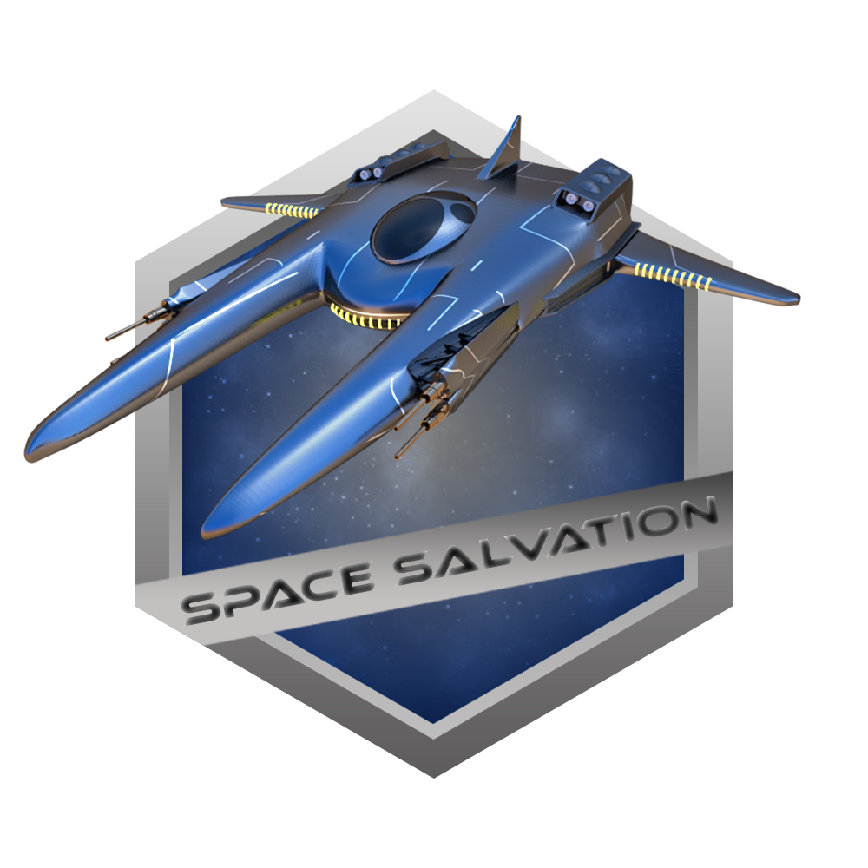

Project Outline
Andrei Laptev | Keshok Sivalingam | Victor Dallarosa Teixeira

Slide 2
Agenda
Game Overview
Planning
Game Instructions
Game Demonstration
Lessons Learned
Future Possibilities

Slide 3
Game Overview
A rundown of Space Salvation

Slide 4
Brief Overview
Genre/Type
Deep Space
Science Fiction
Shoot ‘em Up
2D based
Camera Angle
2D, Aerial View

Slide 5
Game Objective
Defeat enemy ships
Opposing leader has waged war on your species, and he’s battle tested
They pose a big threat to you and the rest of humanity
Take down the leader and bring glory to your people
Save your people from annihilation

Slide 6

Planning
“A goal without a plan is just a wish.” – Antoine de Saint-Exupéry

Slide 7
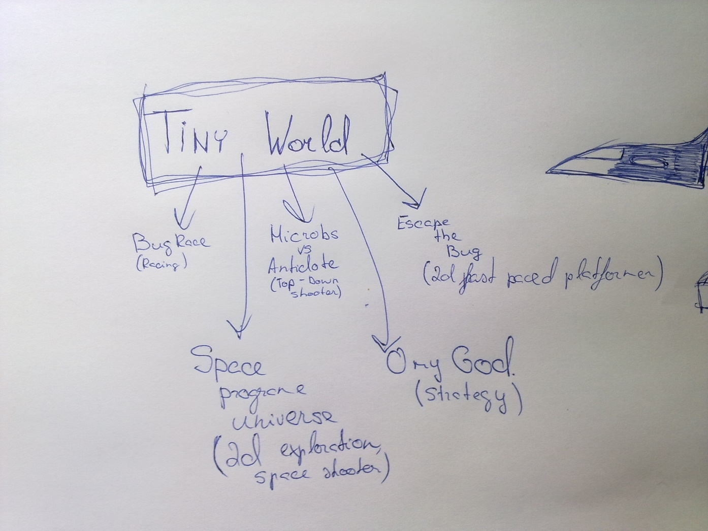
Early Concepts

Slide 8
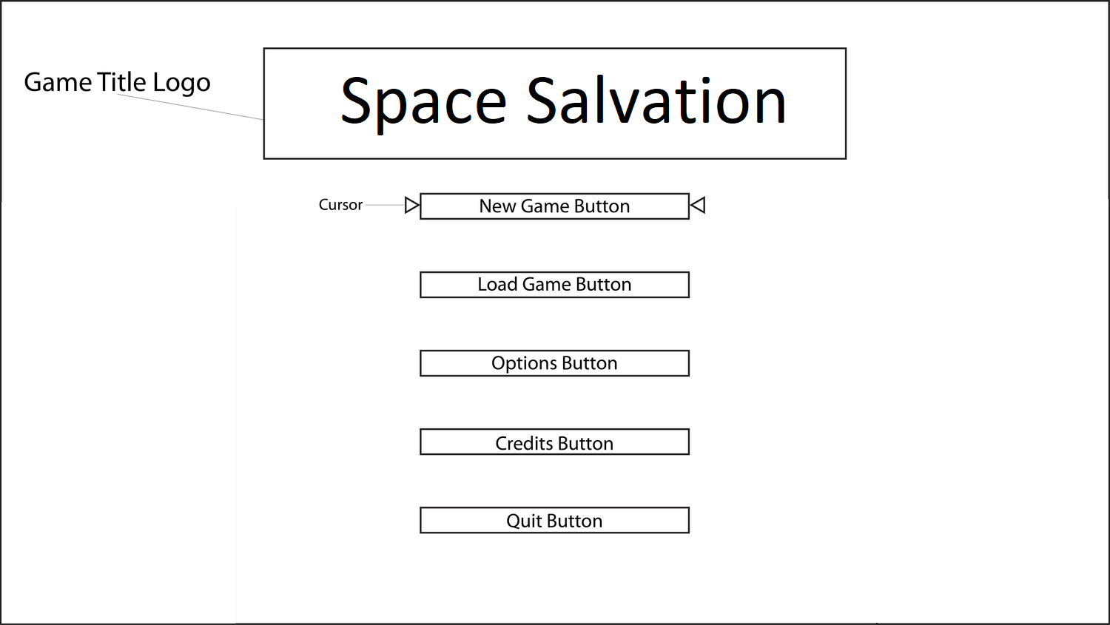
Main Menu

Slide 9
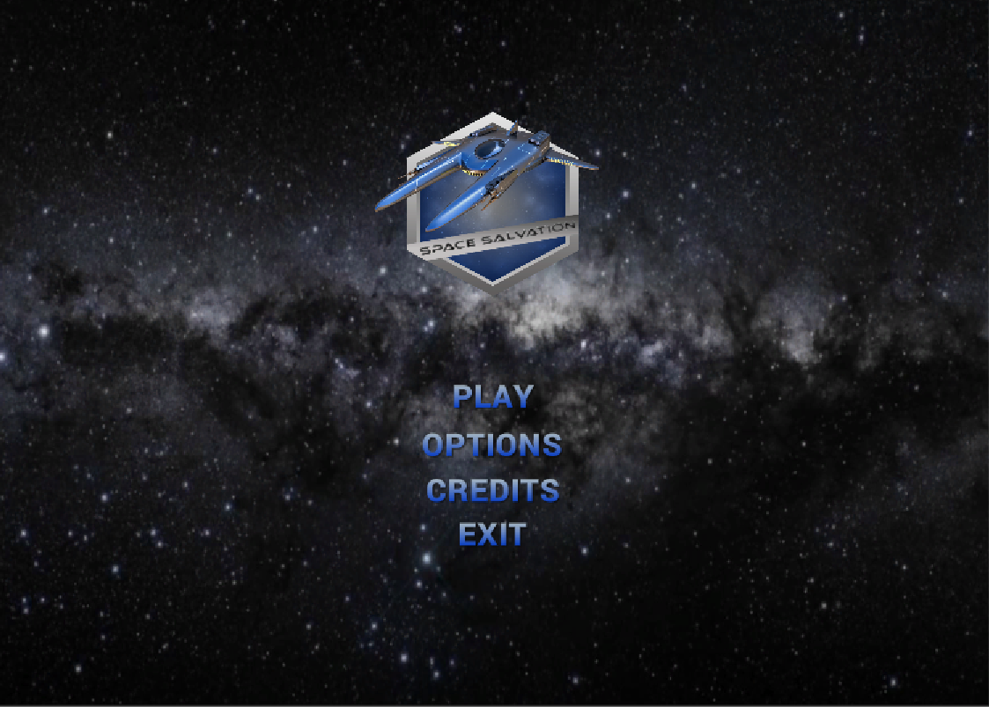
Main Menu (Cont’d…)

Slide 10
Game Instructions
Detailed overview on user controls and gameplay mechanics

Slide 11
Basic Controls
Movements
Ship movement
Speed boost
Shooting
Regular shooting
Nuclear shooting
Mouse navigation
Left shift
Mouse left click / Space
Mouse right click / Left ctrl

Slide 12


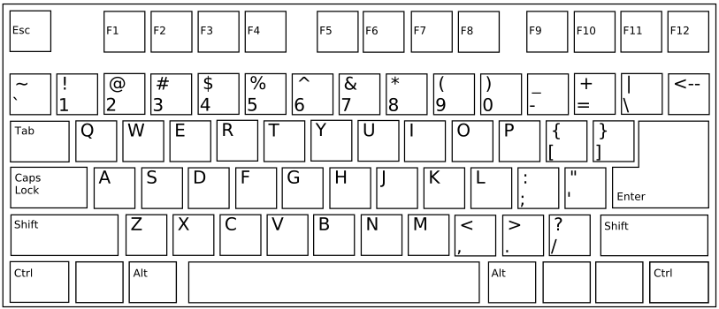
Keyboard and Mouse Control Scheme
Shoot
Boost
Nuclear

Slide 13
Health, Score, Lives and Death Conditions
Health
Initial value 100%
Each hit decreases by 20%
Each Health kit adds 20%
Score
Each star adds 100 points
After 1000 points collected, 1 extra life granted
After each level completion + 200 points
Lives
Initial quantity 3
After each 10 stars collected + 1 life
Death
Once all lives lost
Once being hit with asteroid

Slide 14
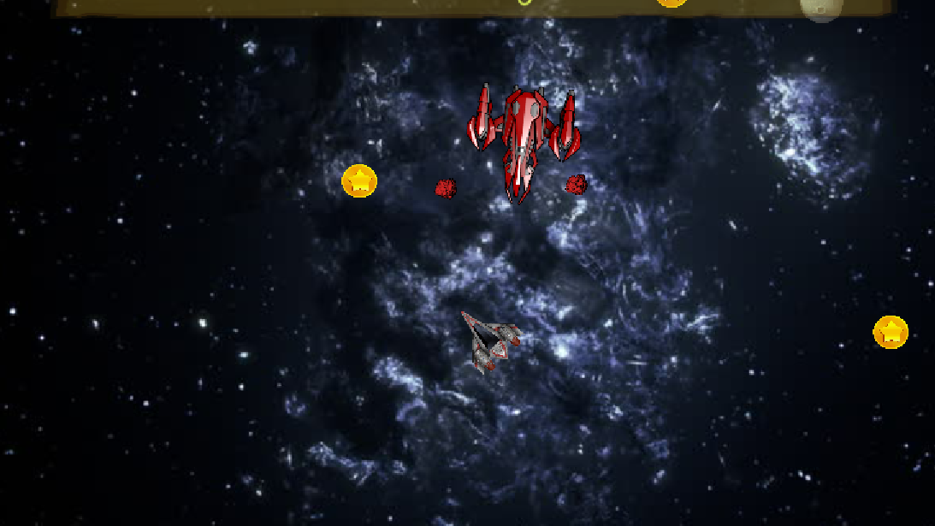
Level 1
Task:
Dodge the enemy’s bullets and shoot back
Each hit reduces Enemy’s health by 20%
Collect coins to get extra points / life
Collect health kits; each adds 20%
Avoid asteroids collision!

Slide 15
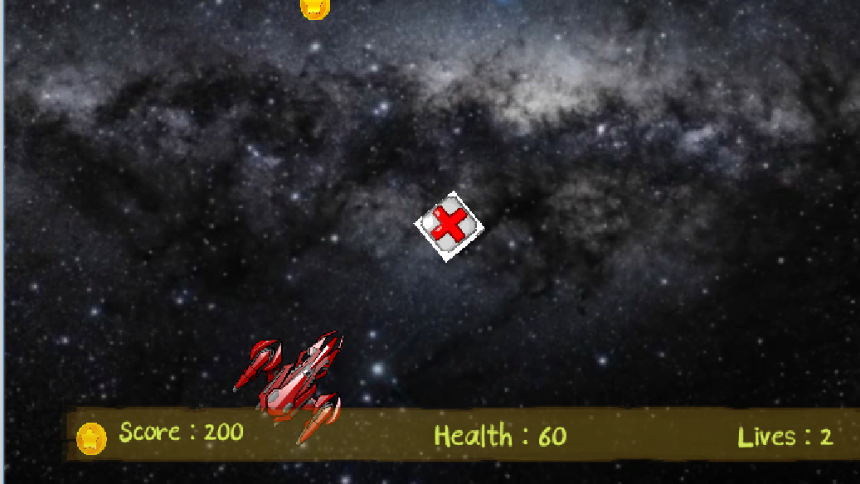
Level 2
Task:
Dodge the enemy’s bullets and shoot back
Each hit reduces Enemy’s health by 20%
Collect coins to get extra points / life
Collect health kits; each adds 20%
After first enemy destroyed, expect second one!

Slide 16
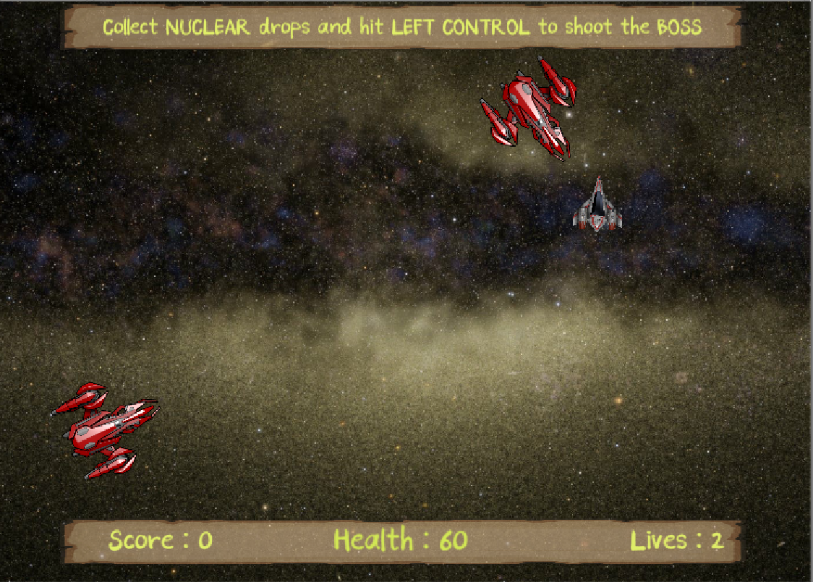
Level 3
Task:
Enemies shoot simultaneously!
Dodge the enemies’ bullets and shoot back
Each hit reduces Enemy’s health by 20%. After destroy, collect nuclear drops they emitting

Slide 17
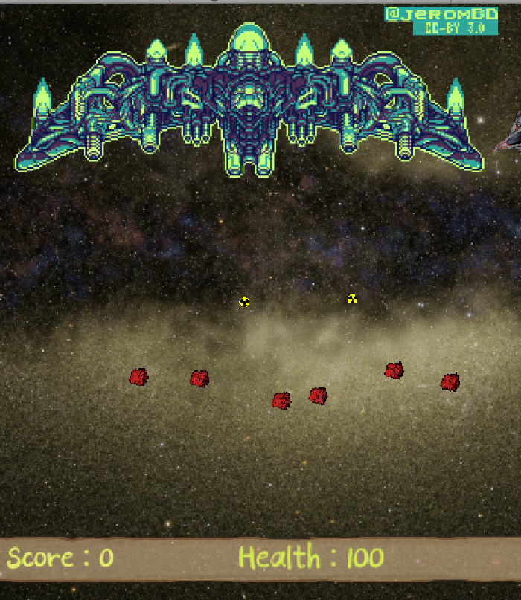
Level 3 (Cont’d…)
Task:
After enemies destroyed, Boss comes to the scene
Use regular bullets to reduce Boss’s health by 5% and nuclear that take off 25%
Boss also drops nuclear bombs – collect them to shoot

Slide 18
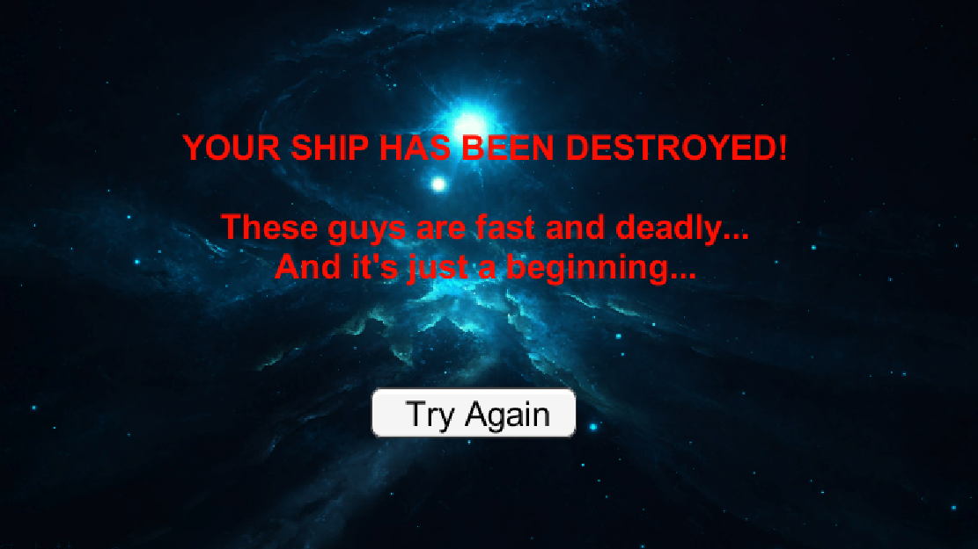
Player Death Title Screen

Slide 19
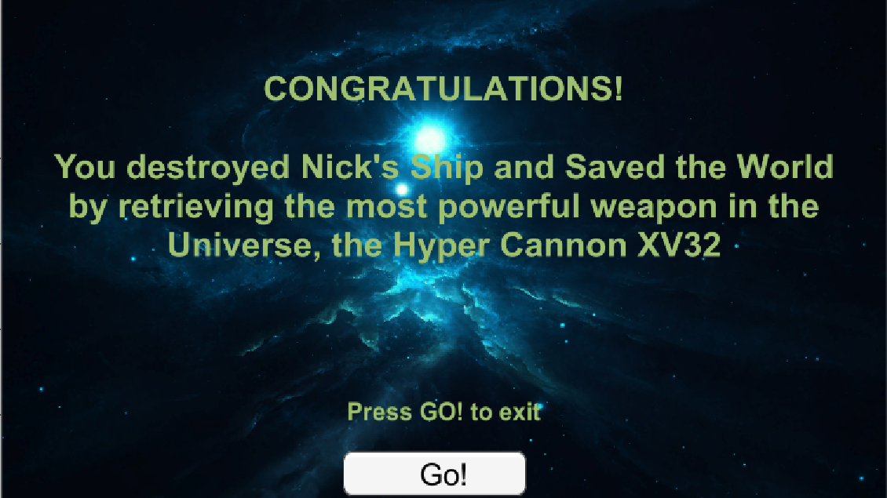
Player Victory Title Screen

Slide 20
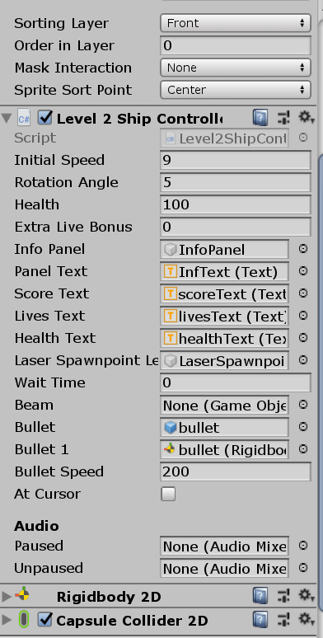
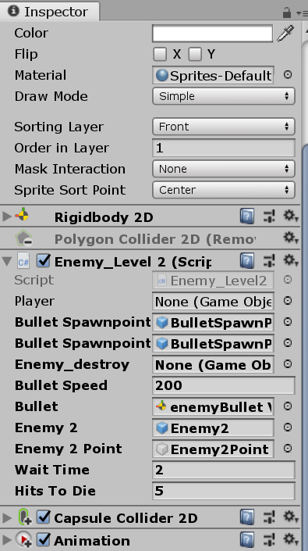
Complexity Adjustments

Slide 21
Game Demonstration
Experience Space Salvation in its full glory!

Slide 22

Final Build Demo
Click on the image to play Space Salvation
Space Salvation – Final Build (v4)
https://andreilaptev.itch.io/finalbuild

Slide 23
Lessons Learned
“When the going gets tough, the tough get going.” – Billy Ocean

Slide 24
Trial and Errors
Discoveries
Challenges
Work on the levels of objects
Work on the levels of entire components
Building game level designs with minimal coding (Unity)
The power of Unity
The power of using GitHub/GitKraken (e.g., version control, tracking changes, reverting back to previous commits, etc.)
Quaternions
Mouse facing
Specific sound tracks control
Animation
Sound effects
Time consumption (i.e., sticking to deadlines)
Merging conflicts on GitKraken

Slide 25
Future Possibilities
Replace mouse control with arrows (i.e., allows Player to toggle between keyboard and mouse movement control schemes)
Adding gamepad control functionality (e.g., Xbox One Controller)
Implementation of camera following ship to extend game world
Adding animated background
Adding blaster beams in shooting

Slide 26

Questions?
“The important thing is not to stop questioning.” – Albert Einstein

Slide 27
Thank You!
This marks the end of our presentation. Enjoy the rest of your evening ☺

